Slide 1
Image Captioning with Semantic Attention
Quanzeng You
Department of Computer Science, University of Rochester, Rochester NY 14627, USA

Slide 2
Contents
Abstract
1. Introduction
1.1. Main contributions
2. Related work
3. Semantic attention for image captioning
3.1. Overall framework
3.2. Input attention model
3.3. Output attention model
3.4. Model learning
4. Visual attribute prediction
4.1. Non-parametric attribute prediction
4.2. Parametric attribute prediction
5. Experiments
5.1. Datasets and settings
5.2. Performance on MS-COCO
5.3. Performance on Flickr30k
5.4. Visualization of attended attributes
5.5. Analysis of attention model
5.6. The role of visual attributes
6. Conclusion

Slide 3
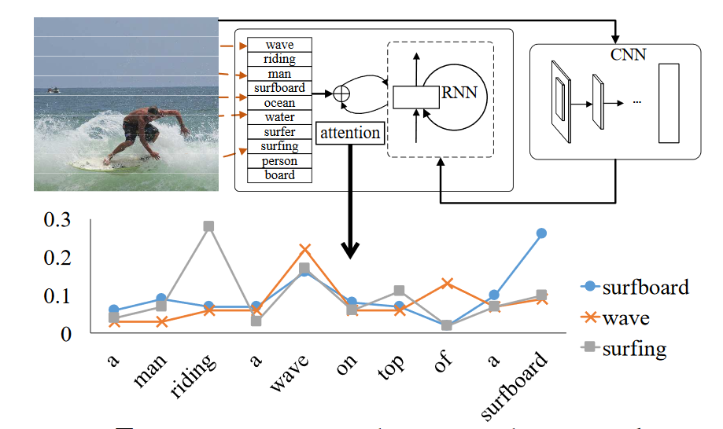
Abstract
Our algorithm learns to selectively attend to semantic concept proposals and fuse them into hidden states and outputs of recurrent neural networks. The selection and fusion form a feedback connecting the top-down and bottom-up computation.
Is it possible to combine the advantages of these two paradigms?

Slide 4
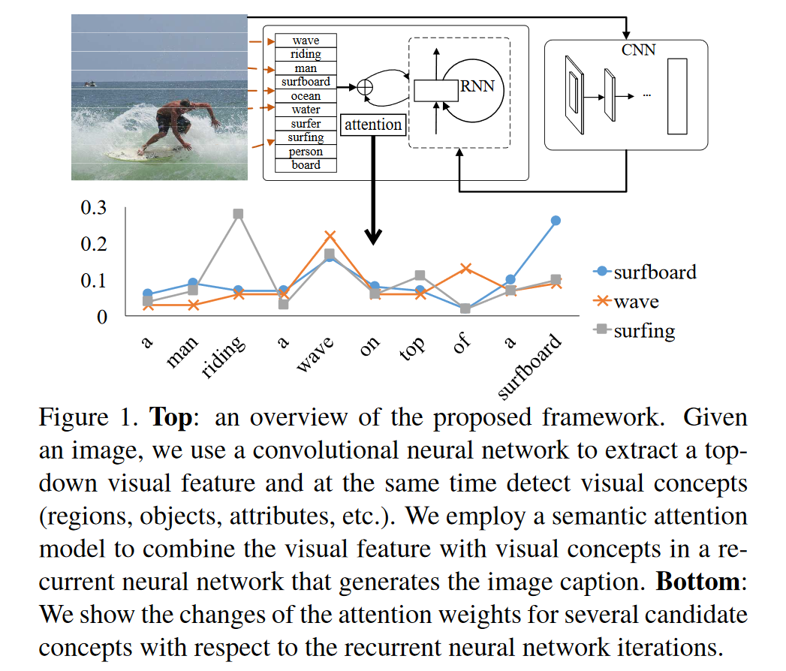
1. Introduction
The problem is also interesting in that it connects Computer Vision with Natural Language Processing which are two major fields in Artificial Intelligence.
There are two general paradigms in existing image captioning approaches: top-down and bottom-up.
the state-of-the-art is the top-down paradigm where there is an end-to-end formulation from an image to a sentence based on recurrent neural networks and all the parameters of the recurrent net work can be learned from training data.
top
the state-of-the-art
The top-down paradigm starts from a “gist” of an image and converts it into words,
bottom
One of the limitations of the top-down paradigm is that it is hard to attend to fine details which may be important in terms of describing the image.
while the bottom-up one first comes up with words describing various aspects of an image and then combines them.
However, they suffer from other problems such as there lacks an end-to-end formulation for the process going from individual aspects to sentences.

Slide 5
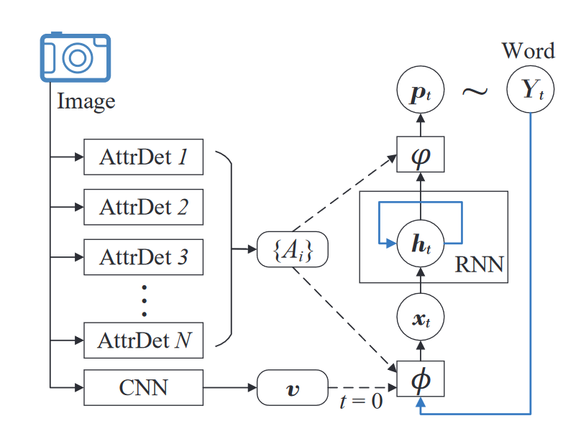
1. Introduction
The visual attention mechanism also plays an important role in natural language descriptions of images biased towards semantics.
Our definition for semantic attention in image captioning is the ability to provide a detailed, coherent description of semantically important objects that are needed exactly when they are needed.
able to attend to a semantically important concept or region of interest in an image,
able to weight the relative strength of attention paid on multiple concepts, and
able to switch attention among concepts dynamically according to task status.
This feedback allows the algorithm to not only predict more accurately new words, but also lead to more robust inference of the semantic gap between existing predictions and image content.
Specifically, we detect semantic concepts or attributes as candidates for attention using a bottom-up approach, and employ a top-down visual feature to guide where and when attention should be activated

Slide 6
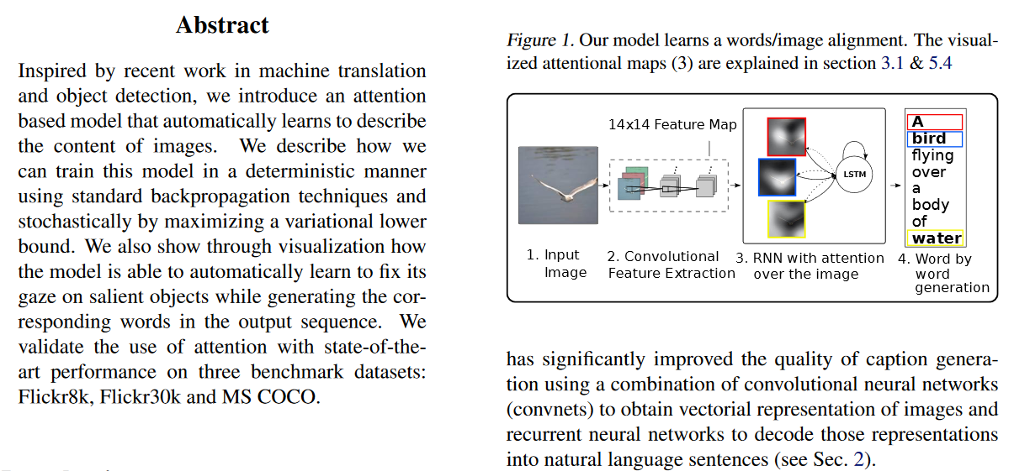
1.1. Main contributions
The main contribution of this paper is a new image captioning algorithm that is based on a novel semantic attention model.
Show, attend and tell: Neural image caption generation with visual attention. InICML, 2015
First, in this paper attention is modeled spatially at a fixed resolution. Instead, we can use concepts from anywhere at any resolution in the image.
Second, in our work there is a feedback process that combines top-down information (the global visual feature) with bottom-up concepts which does not exist in this paper.
Third, in in this paper uses pre-trained feature at a particular spatial location. Instead, we use word features that correspond to detected visual concepts.
This way, we can leverage external image data for training visual concepts and external text data for learning semantics between words

Slide 7
2. Related work
There is a growing body of literature on image captioning which can be generally divided into two categories: top-down(modern) and bottom-up(classical).
Translation is accomplished through recurrent neural networks based language models
Image captioning
Bottom-up approach
Top-down approach
start with visual concepts, objects, attributes, words and phrases, and combine them into sentences using language models.
formulate image captioning as a machine translation problem(these approaches translate from a visual representation to a language counterpart).
The visual representation comes from a convolutional neural network which is often pre-trained for image classification on large-scale datasets.
The main advantage of this approach is that the entire system can be trained from end to end, i.e., all the parameters can be learned from data.

Slide 8
2. Related work
with recurrent neural network
V. Mnih, N. Heess, A. Graves, et al. Recurrent models of visual attention. In NIPS, pages 2204–2212, 2014
with Boltzmann machines
H. Larochelle and G. E. Hinton. Learning to combine foveal glimpses with a third-order boltzmann machine. In NIPS, pages 1243–1251, 2010
Y. Tang, N. Srivastava, and R. R. Salakhutdinov. Learning generative models with visual attention. In NIPS, pages1808–1816, 2014
for image tracking
M. Denil, L. Bazzani, H. Larochelle, and N. de Freitas. Learning where to attend with deep architectures for image tracking. Neural computation, 24(8):2151–2184, 2012
for image recognition of multiple objects
J. Ba, V. Mnih, and K. Kavukcuoglu. Multiple object recognition with visual attention. ICLR, 2015
for image generation
K. Gregor, I. Danihelka, A. Graves, and D. Wierstra. Draw:A recurrent neural network for image generation. arXivpreprint arXiv:1502.04623, 2015.3

Slide 9
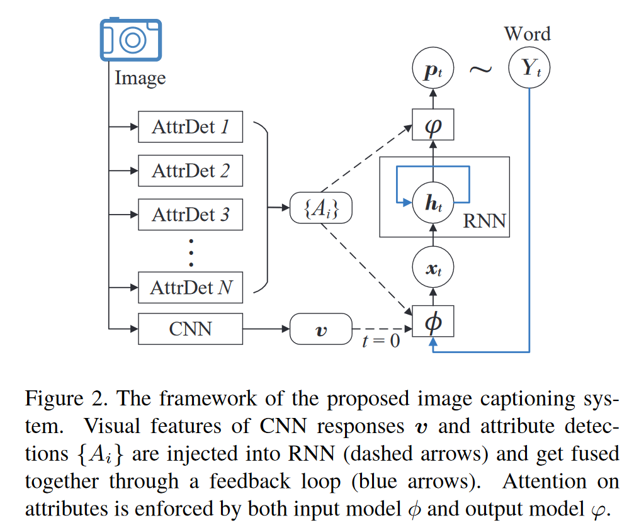
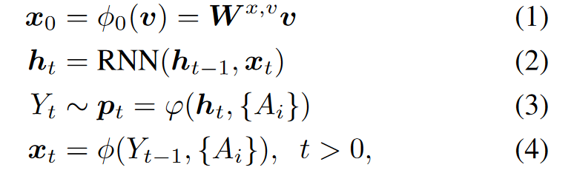
3.1. Overall framework
We extract both top-down and bottom-up features from an input image
All the visual features are fed into a Recurrent Neural Network (RNN) for caption generation
Different from previous image captioning methods, our model has a unique way to utilize and combine different sources of visual information

Slide 10
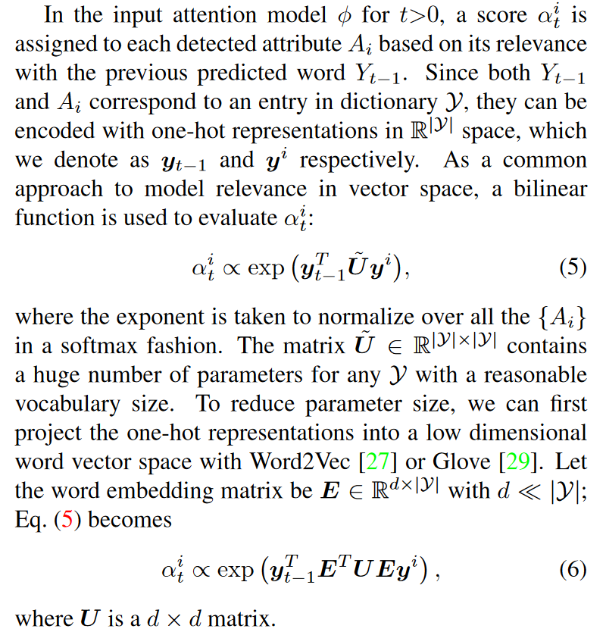
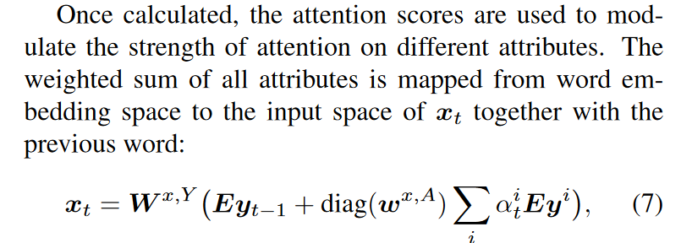
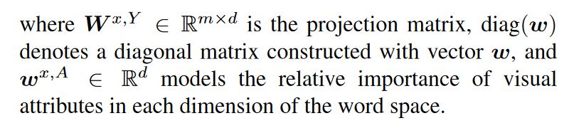
3.2. Input attention model

Slide 11
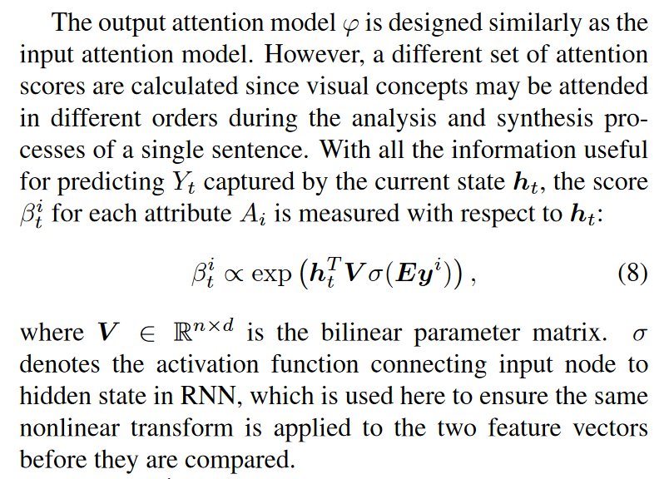
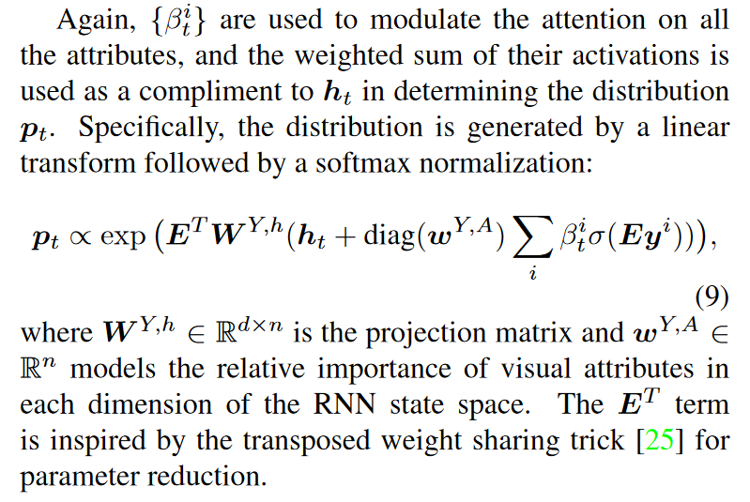
3.3. Output attention model

Slide 12
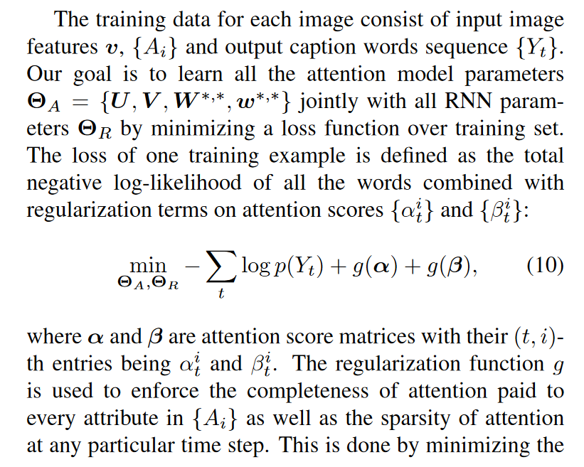
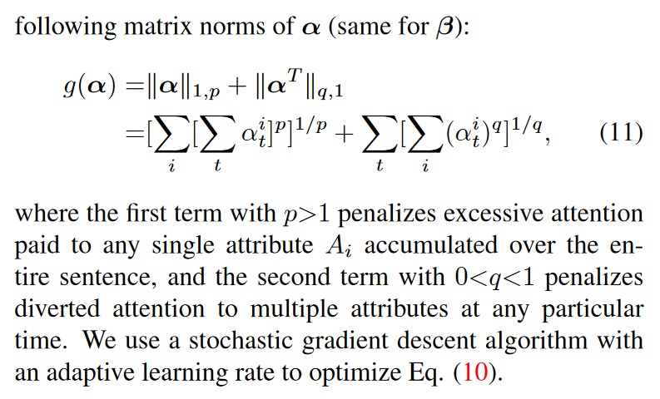
3.4. Model learning

Slide 13
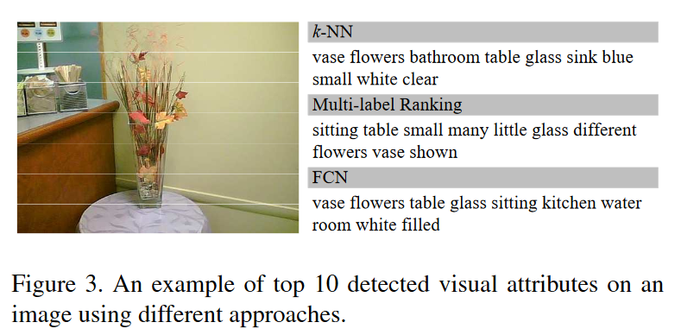
4. Visual attribute prediction
The prediction of visual attributes {A_i} is a key component of our model in both training and testing.
First, we explore a non-parametric method based on nearest neighbor image retrieval from a large collection of images with rich and unstructured textual metadata such as tags and caption.
The attributes for a query image can be obtained by transferring the text information from the retrieved images with similar visual appearance.
The second approach is to directly predict visual attributes from the input image using a parametric model.
This is motivated by the recent success of deep learning models on visual recognition tasks [10,18].
Note that the two approaches to obtain attributes are complementary to each other and can be used jointly.

Slide 14
4.1. Non-parametric attribute prediction
One of the fundamental assumptions is that similar images are likely to share similar and correlated annotations.
Therefore, it is possible to discover useful annotations and descriptions from visual neighbors in a large-scale image dataset.
We extract key words as the visual attributes for our model from a large image dataset.
We use the GoogleNet feature to evaluate image distances, and employ simple Term-Frequency (TF) to select the most frequent words in the ground-truth captions of the retrieved training images. (C. Szegedy, W. Liu, Y. Jia, P. Sermanet, S. Reed,D. Anguelov, D. Erhan, V. Vanhoucke, and A. Rabinovich.Going deeper with convolutions. InCVPR, 2015.)

Slide 15
4.2. Parametric attribute prediction
In addition to retrieved attributes, we also train parametric models to extract visual attributes.
The resulting attributes are treated as a set of predefined categories and can be learned as in a conventional classification problem.
In this paper we mainly investigate two state-of-the-art deep learning models for attribute prediction:
using a ranking loss as objective function to learn a multi-label classifier (Y. Gong, Y. Jia, T. Leung, A. Toshev, and S. Ioffe. Deep convolutional ranking for multi-label image annotation. ICLR,2014.5)
using a Fully Convolutional Network (FCN) to learn attributes from local patches (H. Fang, S. Gupta, F. Iandola, R. Srivastava, L. Deng, P. Doll ́ar, J. Gao, X. He, M. Mitchell, J. Platt, et al. From captions to visual concepts and back. In CVPR, pages 1473–1482, 2015.1,2,5)
Both two methods produce a relevance score between an image and a visual attribute, which can be used to select the top ranked attributes as input to our captioning mode

Slide 16
5. Experiments
We report all the results using Microsoft COCO caption evaluation tool, including BLEU, Meteor, Rouge-L and CIDEr.

Slide 17
5.1. Datasets and settings
Flickr30k has a total of 31,783 images.
MS-COCO is more challenging, which has 123,287 images.
Each image is given at least five captions by different AMT workers.
We also follow the publicly available code to preprocess the captions (i.e. building dictionaries, tokenizing the caption). (A. Karpathy and L. Fei-Fei. Deep visual-semantic alignments for generating image descriptions. InCVPR, June2015)
Our captioning system is implemented based on a Long Short-Term Memory (LSTM) network. (O. Vinyals, A. Toshev, S. Bengio, and D. Erhan. Show and tell: A neural image caption generator. In CVPR, pages 3156–3164, 2015.)
We set n=m=512 for the input and hidden layers, and use tanh as nonlinear activation function σ.
We use Glove feature representation with d= 300 dimensions as our word embedding E. (J. Pennington, R. Socher, and C. D. Manning. Glove: Global vectors for word representation. EMNLP, 12:1532–1543,2014.)
The image feature vis extracted from the last 1024-dimensional convolutional layer of the GoogleNet CNN model. (C. Szegedy, W. Liu, Y. Jia, P. Sermanet, S. Reed,D. Anguelov, D. Erhan, V. Vanhoucke, and A. Rabinovich. Going deeper with convolutions. In CVPR, 2015.5
Our attribute detectors are trained for the same set of visual concepts as in for Microsoft COCO dataset. (H. Fang, S. Gupta, F. Iandola, R. Srivastava, L. Deng, P. Doll ́ar, J. Gao, X. He, M. Mitchell, J. Platt, et al. From captions to visual concepts and back. In CVPR, pages 1473–1482, 2015)
We build and train another independent set of attribute detectors for Flickr30k following the steps in on its training split. (H. Fang, S. Gupta, F. Iandola, R. Srivastava, L. Deng, P. Doll ́ar, J. Gao, X. He, M. Mitchell, J. Platt, et al. From captions to visual concepts and back. In CVPR, pages 1473–1482, 2015)
The top10 attributes with highest detection scores are selected to form the set {A_i} in our best attention model setting.
In training, we use RMSProp algorithm to do model updating with a mini-batch size of256. (T. Tieleman and G. Hinton. Lecture 6.5 - rmsprop, coursera: Neural networks for machine learning. 2)
The regularization parameters are set as p= 2, q= 0.5. (H. Fang, S. Gupta, F. Iandola, R. Srivastava, L. Deng,P. Doll ́ar, J. Gao, X. He, M. Mitchell, J. Platt, et al. From captions to visual concepts and back. In CVPR, pages 1473–1482, 2015)
All our results are obtained with the ensemble of 5 identical models trained with different initializations, which is a common strategy adopted in other work. (O. Vinyals, A. Toshev, S. Bengio, and D. Erhan. Show and tell: A neural image caption generator. In CVPR, pages 3156–3164, 2015.)
In the following experiments, we evaluate different ways to obtain visual attributes as described in Section4, including one non-parametric method (k-NN) and two parametric models trained with ranking-loss (RK) and fully-connected network (FCN).
Besides the attention model (ATT) described in Section3, two fusion-based methods to utilize the detected attributes {A_i} are tested by simply taking the element-wise max (MAX) or concatenation (CON) of the embedded attribute vectors {Ey^i}.
The combined attribute vector is used in the same framework and applied at each time step.

Slide 18
5.2. Performance on MS-COCO & 5.3. Performance on Flickr30k
Note that the overall captioning performance will be affected by the employed visual attributes generation method.
Therefore, we first assume ground truth visual attributes are given and evaluate different ways (CON, MAX, ATT) to select these attribute.
To be more specific, we select the most common words as visual attributes from their ground-truth captions to help the generation of caption.
These results can be considered as the upper bound of the proposed models, which suggest that all of the proposed models (ATT, MAX and CON) can significantly improve the performance of image captioning system, if given visual attributes of high quality.
Now we evaluate the complete pipeline with both attribute detection and selection.
Table2 shows the performance of the proposed model on the validation set.
Note that B-1 is related to single word accuracy, the performance gap ofB-1 between our model and [37] may be due to different preprocessing for word vocabularies.
In general, attention model ATT with attributes predicted by FCN model yields better performance than other combinations over all benchmark.
For attribute fusion methods MAX and CON, we find using the top3 attributes gives the best performance.
Due to the lack of attention scheme, too many keywords may increase the parameters for CON and may reduce the distinction among different groups of keywords for MAX.
MAX and CON can also outperform the state-of-the-art models in most evaluation metrics using visual attributes predicted by FCN.
On the other hand, visual attributes predicted by ranking loss (RK) based model seem to have even worse performance than k-NN.
This is possible due to the lack of local features in training the ranking loss based attribute detectors.

Slide 19
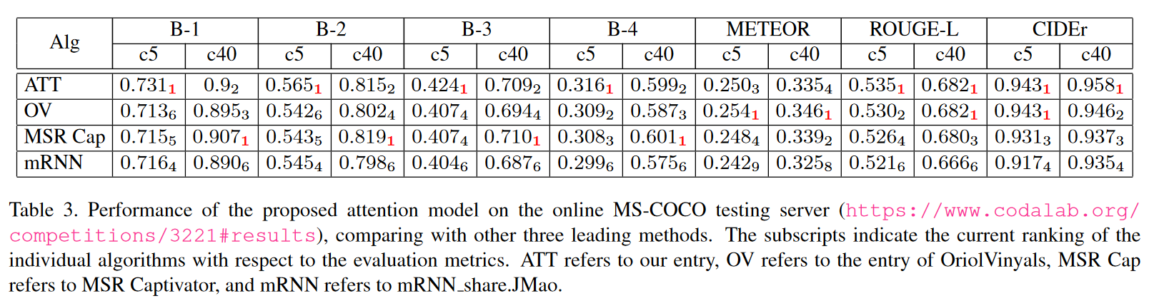
5.2. Performance on MS-COCO & 5.3. Performance on Flickr30k
Performance on MS-COCO 2014 test server

Slide 20
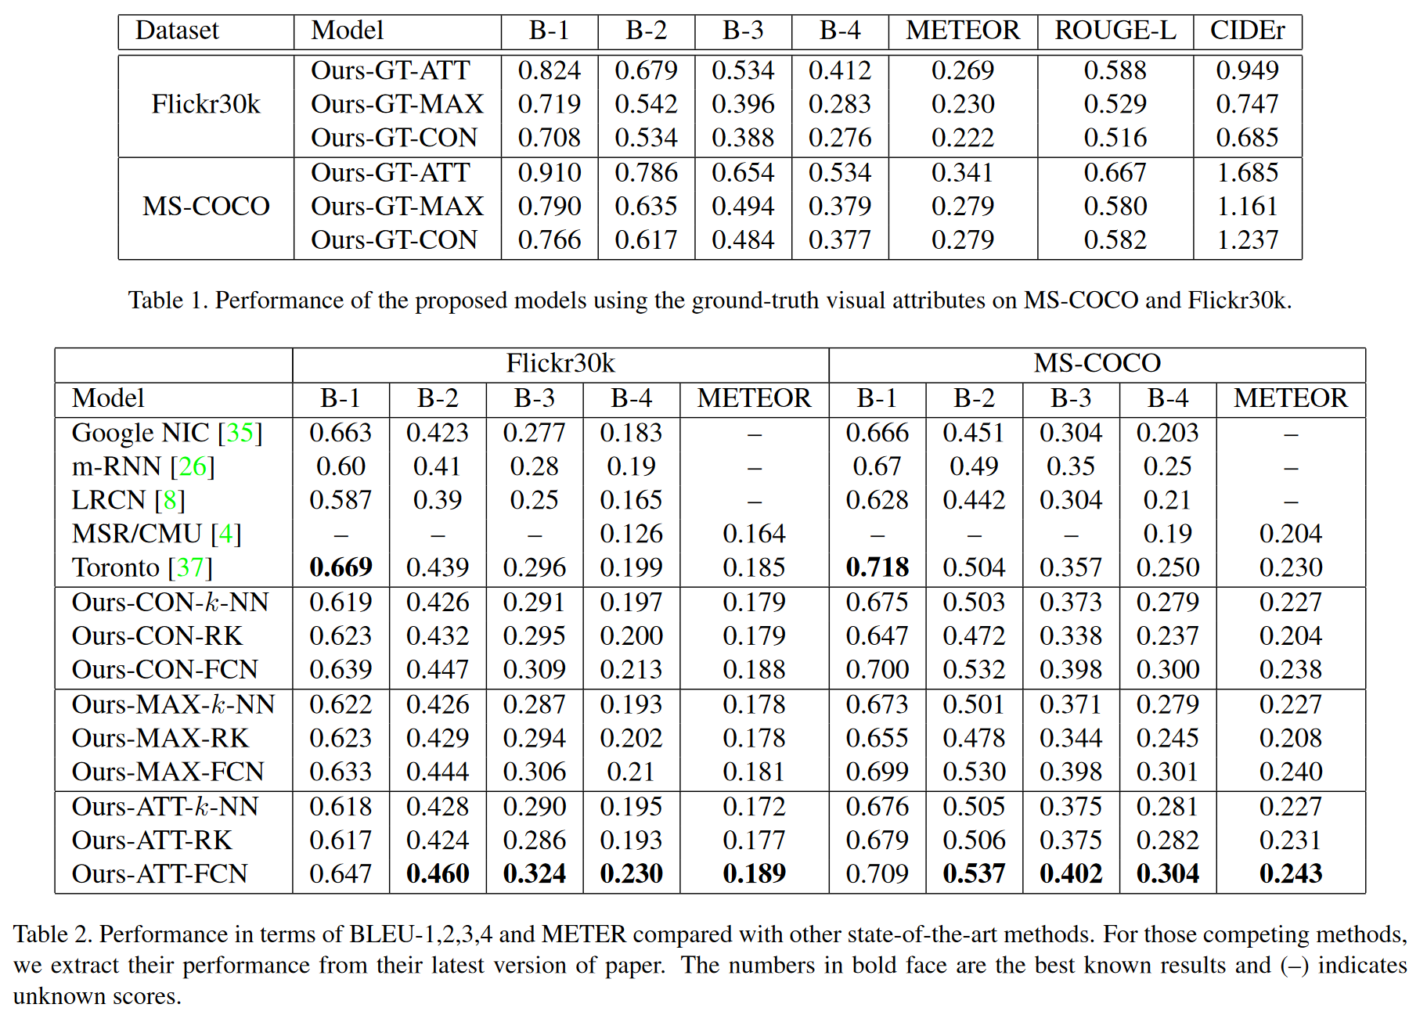
5.2. Performance on MS-COCO & 5.3. Performance on Flickr30k

Slide 21
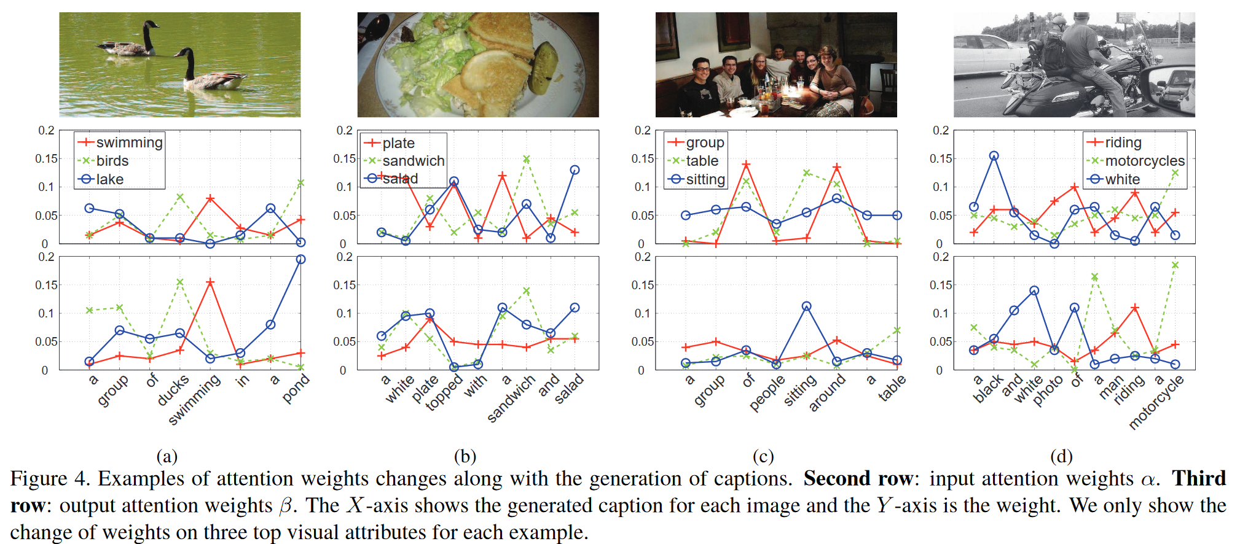
5.4. Visualization of attended attributes
Figure4 contains the generated captions for several images with the input attention weights α and the output attention weights β plotted at each time step.
In general, the activations of both α and β have strong correlation with the words generated.
It is also observed that, as the output attention weight, β correlates with output words more closely; while the input weights α are allocated more on background context such as the “plate” in Figure 4(b) and the “group” in Figure 4(c).

Slide 22
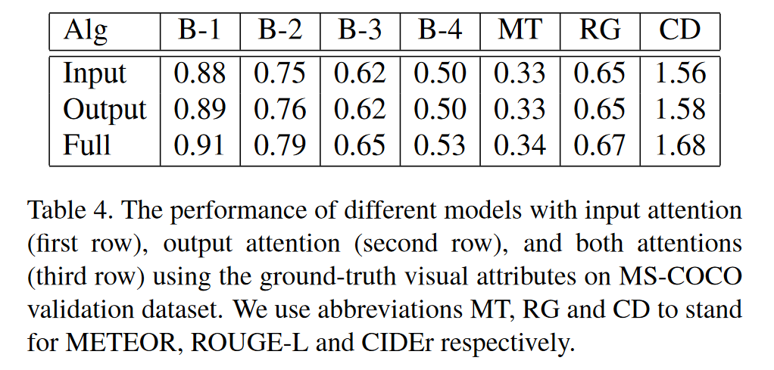
5.5. Analysis of attention model
We evaluate the effect of each of the individual attention modules on the final performance by turning off one of the attention modules while keeping the other one in our ATT-FCN model.
The performance of using output attention is slightly better than only using input attention on some metrics.
However, the combination of this two attentions improves the performance by several percents on almost every metric.

Slide 23
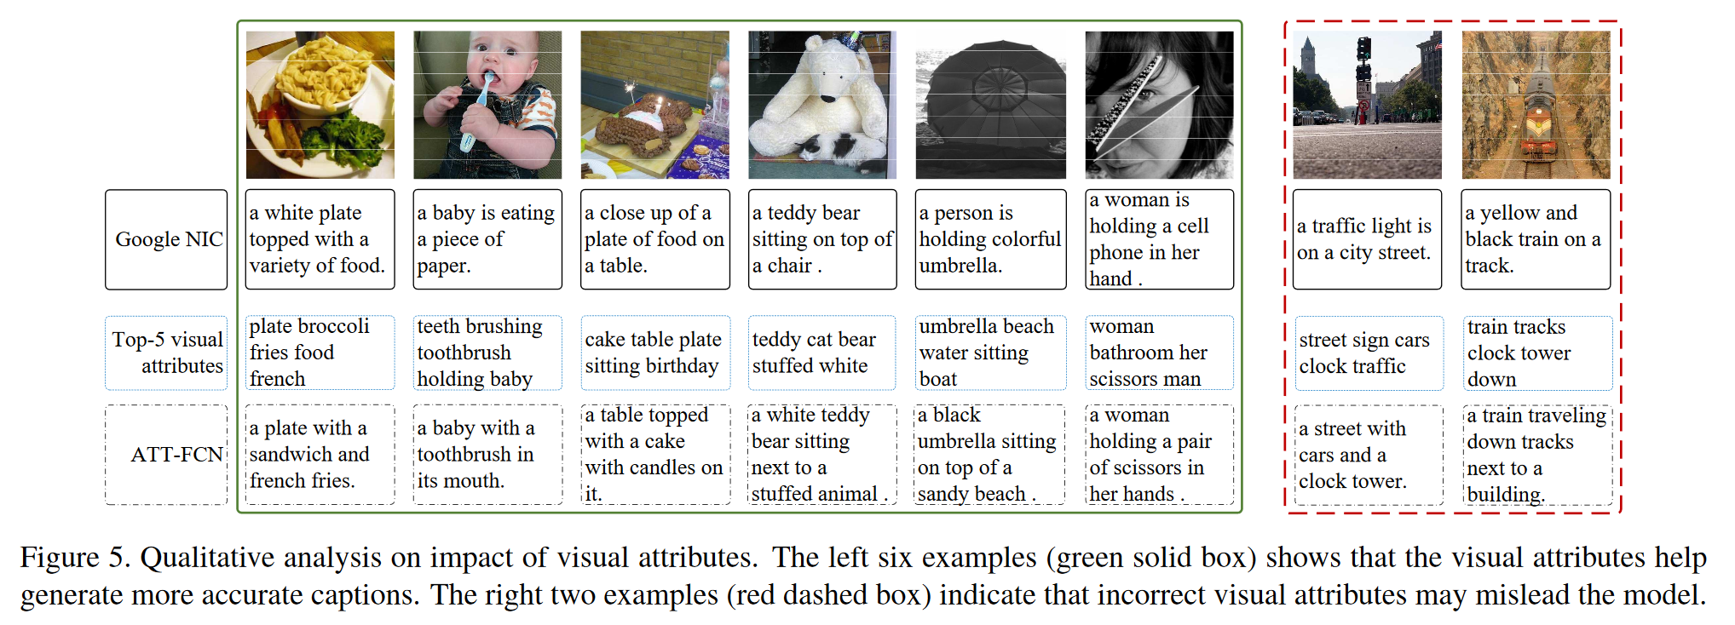
5.6. The role of visual attributes
a qualitative analysis
however, irrelevant visual attributes may disrupt the model to attend on incorrect concepts
We can find that visual attributes can help our model to generate better captions, as shown by the examples in the green box.

Slide 24
6. Conclusion
Different from previous work, our method combines top-down and bottom-up strategies to extract richer information from an image, and couples them with a RNN that can selectively attend on rich semantic attributes detected from the image.
Our method, therefore, exploits not only an overview under-standing of input image, but also abundant fine-grain visual semantic aspects.
The real power of our model lies in its ability to attend on these aspects and seamlessly fuse global and local information for better caption.

